Slide 1
Glendale Quiet Zone
Village Update
11.07.16

Slide 2
Preliminary Concepts Quiet Zone Improvements

Slide 3
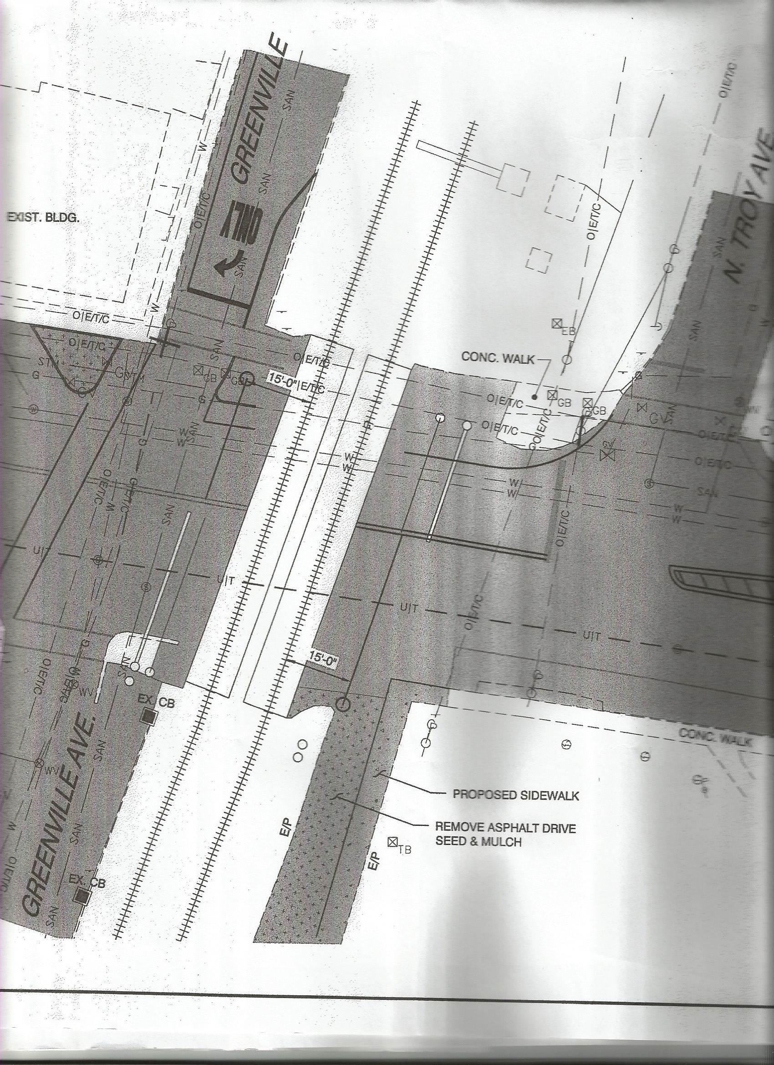
N. Greenville

Slide 4
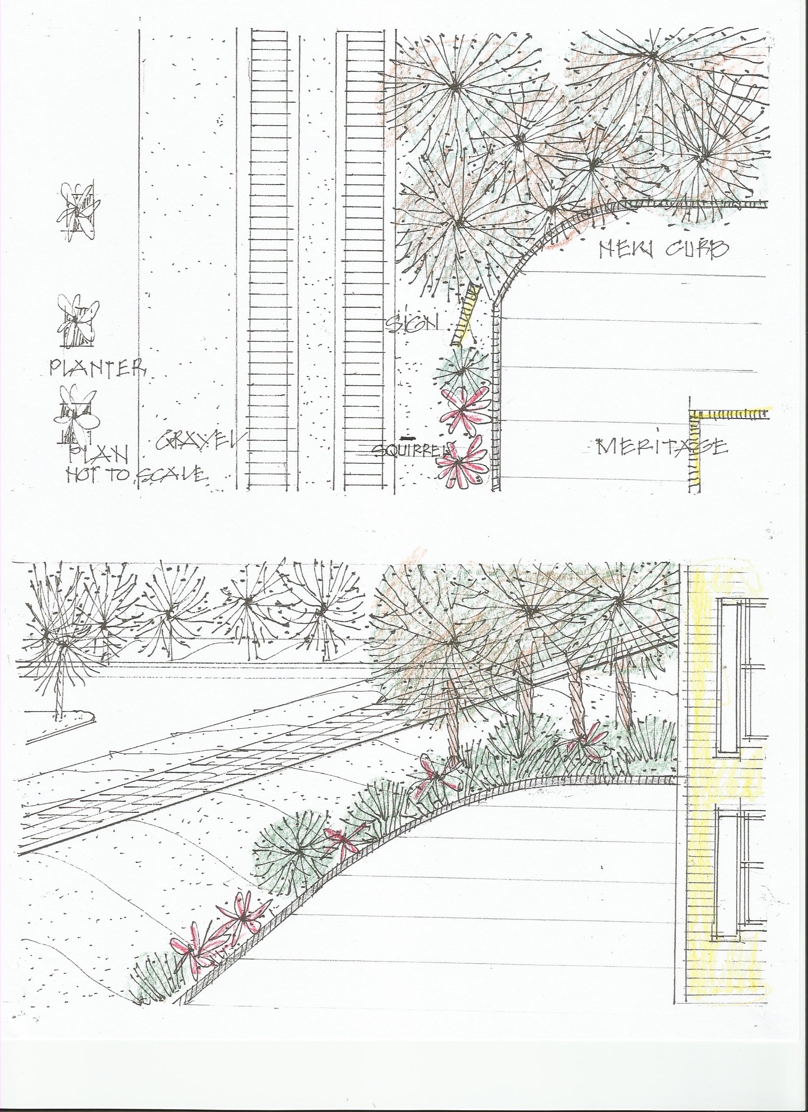
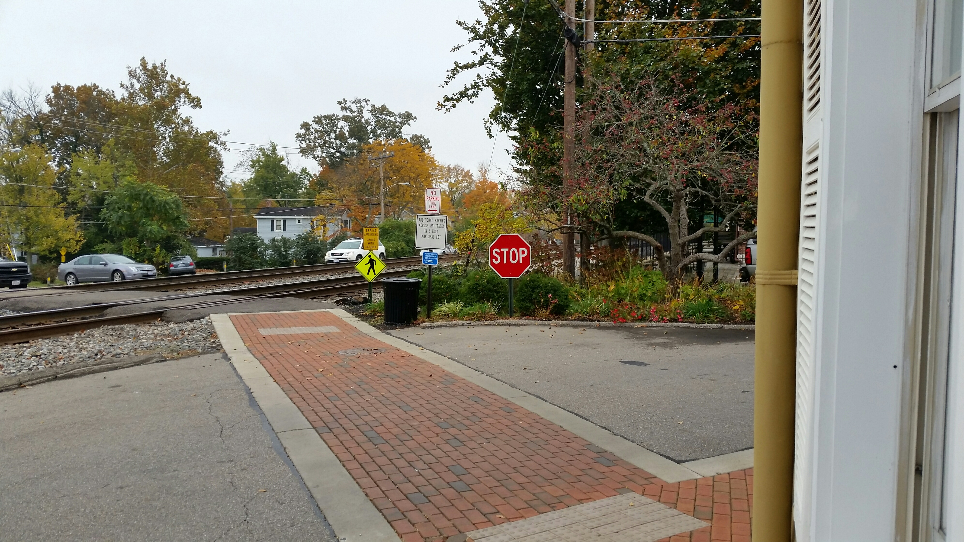
Proposed
Current
Pedestrian
Crossing

Slide 5
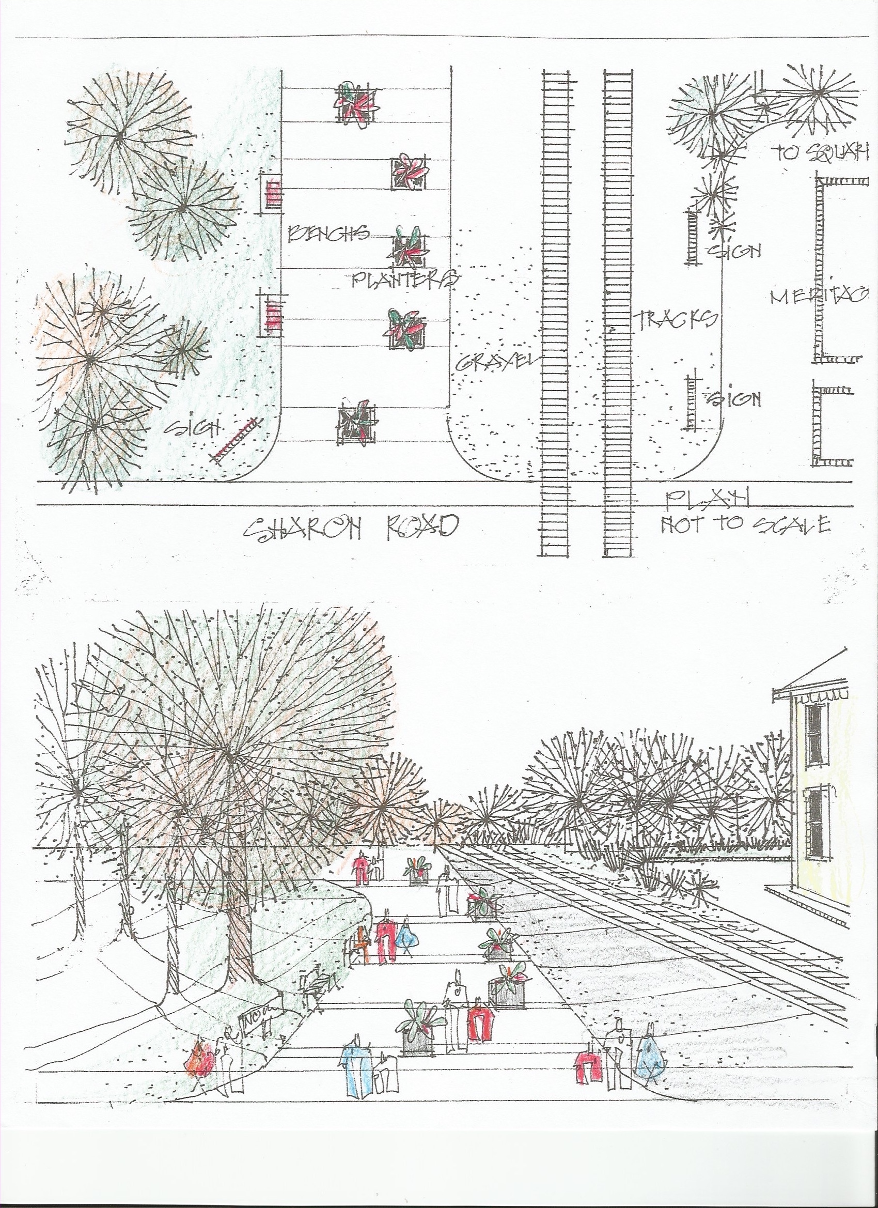
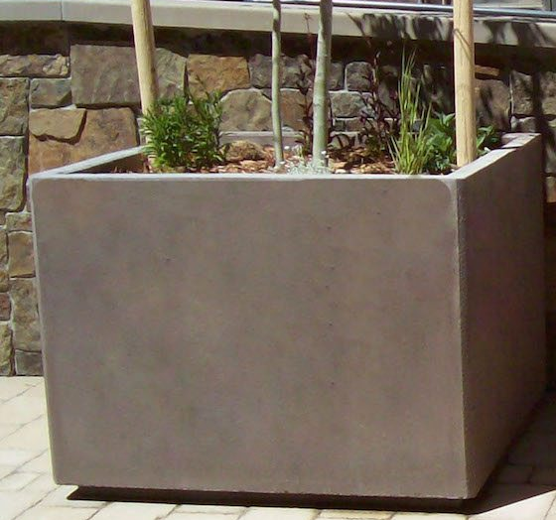
Proposed
Pedestrian
Crossing

Slide 6
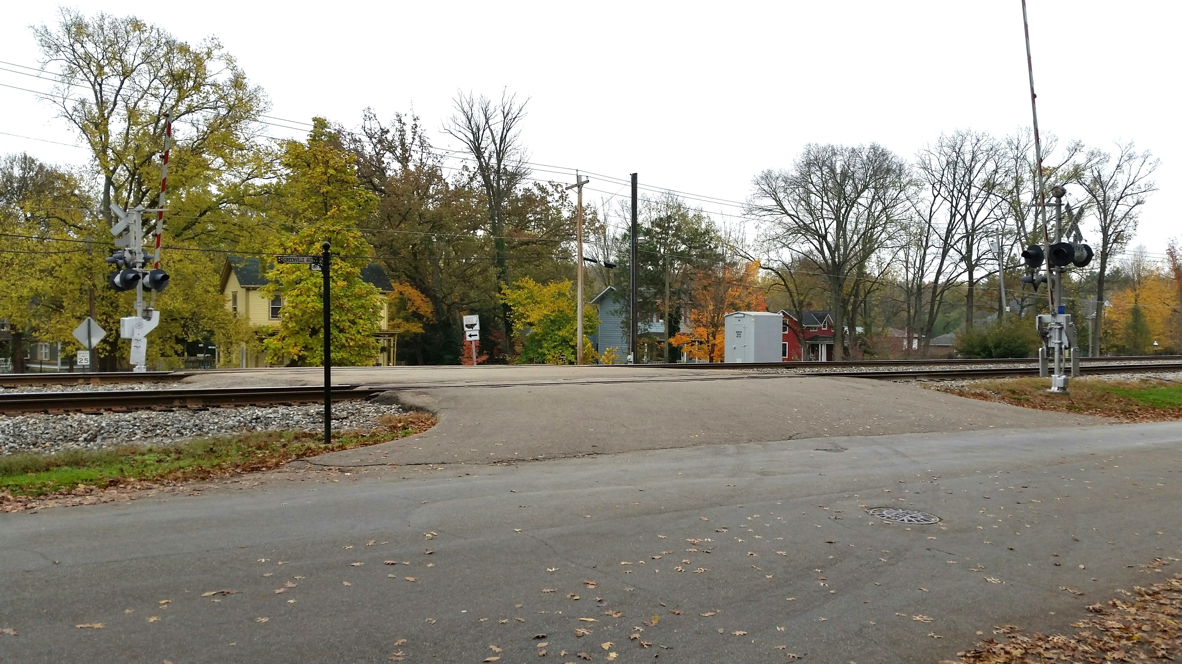
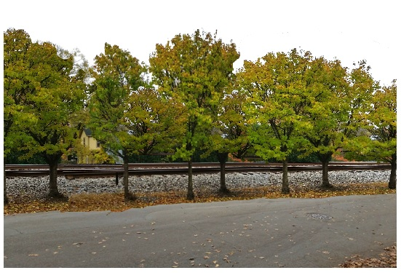
Current
Albion
Crossing
Proposed

